Slide 1





Slide 2




Executive Summary
Problem
Solution/ Value Proposition
Market Validation/ Why now?
Product Roadmaps- How it works
Market Sizes
Business Model/ Benefit
Our projections and milestones
Competition
Competitive Advantage/ Opportunity
Target Market/ Audience
Marketing Plan/ Go-to Market
Founding Team
Fundraising
Potential Outcomes/ Cash flow
Contact us

Slide 3







Slide 4










Slide 5



Slide 6






Slide 7





Slide 8






Slide 9






Slide 10




Slide 11

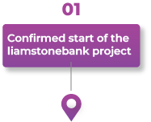
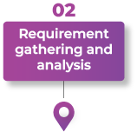
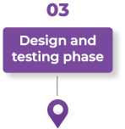

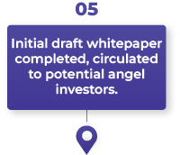

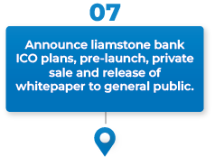


Slide 12
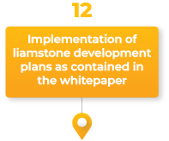
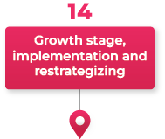
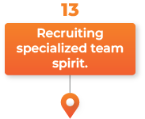


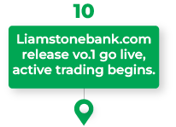
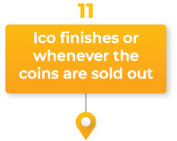


Slide 13



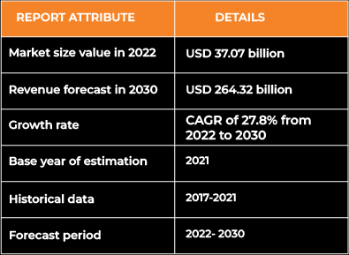


Slide 14





Slide 15



Slide 16










Slide 17
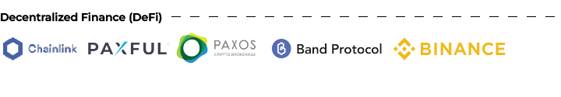




Slide 18



Slide 19




Slide 20
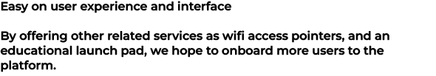
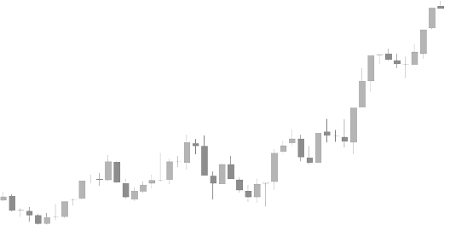


Slide 21













Slide 22







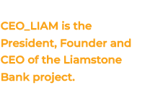



Slide 23






Slide 24
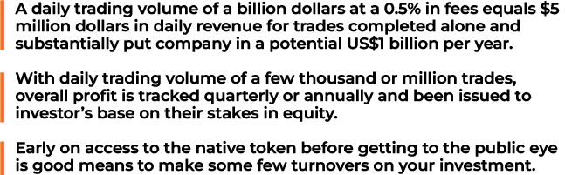

Slide 25




